Slide 1


St Eugene’s primary school & nursery unit
Primary One Induction
27th May 2026

Slide 2
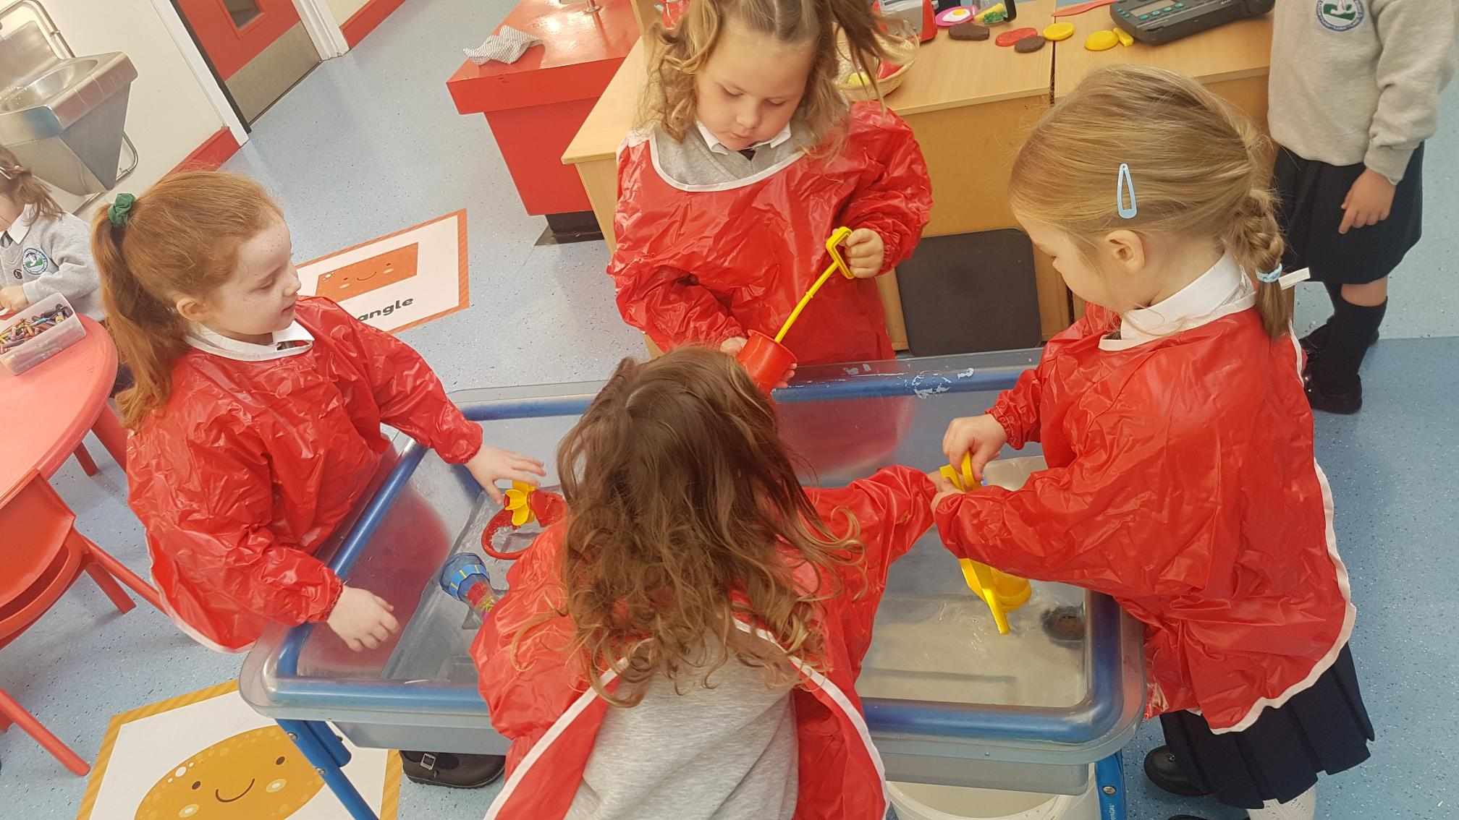
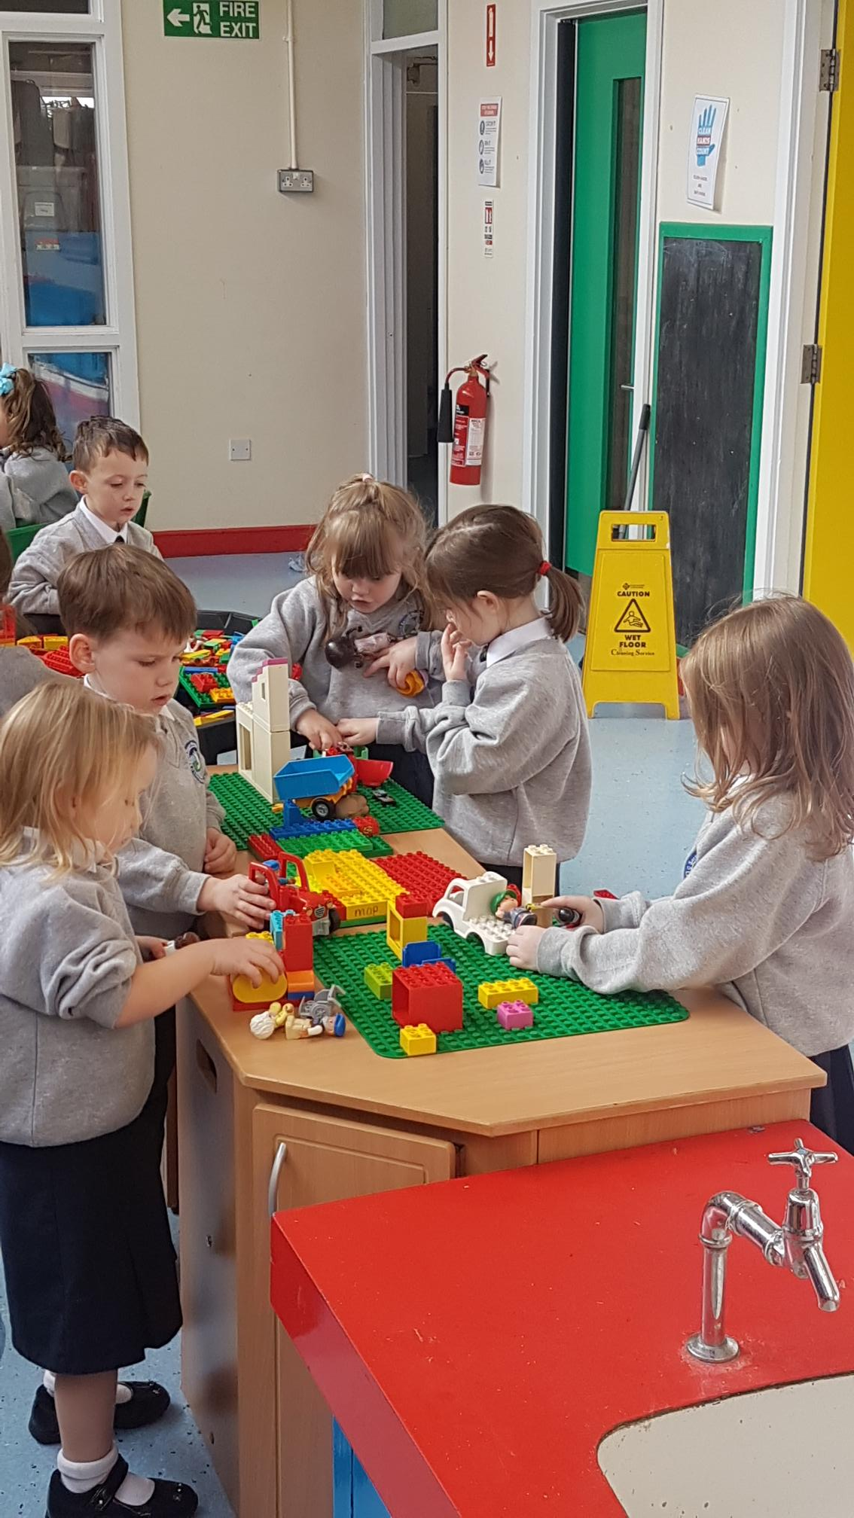
Welcome
Welcome to our Primary 1 induction.
In this session we will cover staff, uniforms, school dates and times, role of parents in supporting pupils and who your child’s teacher is.
Our school motto is Do Your Best and we embed this into our daily teaching provision.
We are looking forward to welcoming you and your little one into our school community.
.

Slide 3
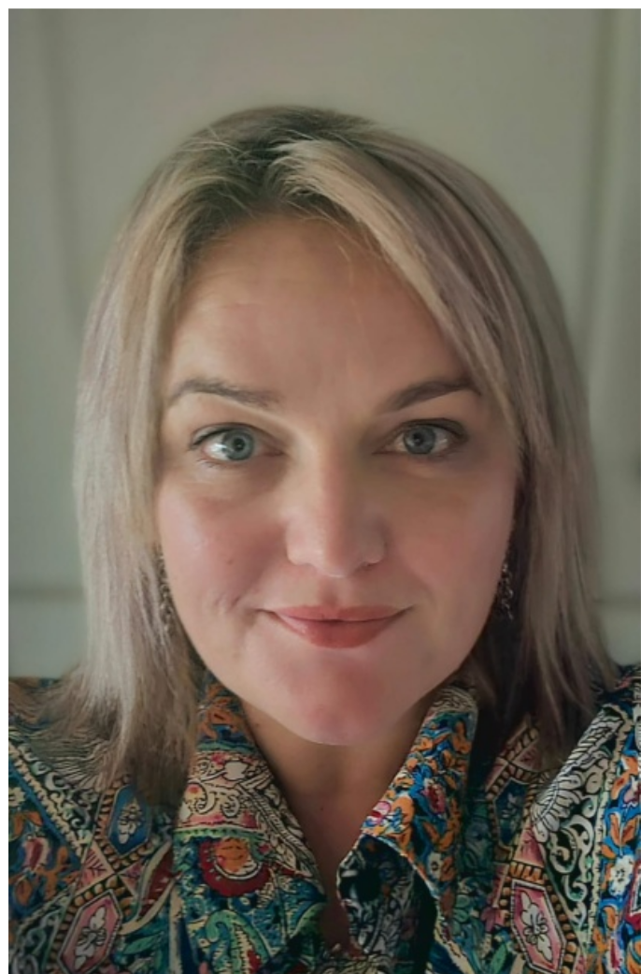
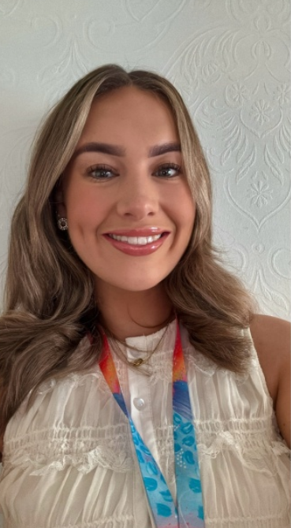
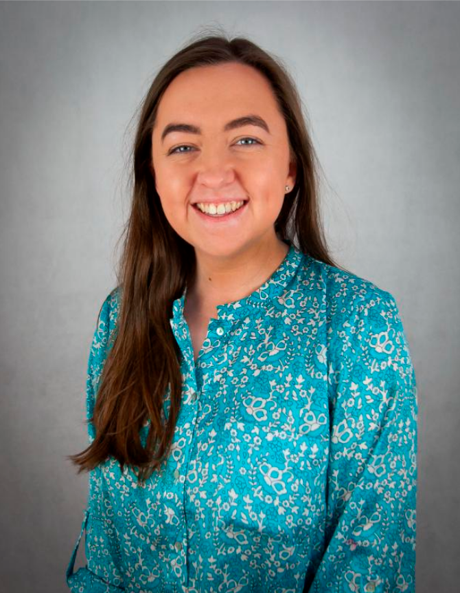
MEET THE STAFF
Mrs. Deane Miss. McKenna Miss. McNutt
Acting Principal P1 Teacher SENCO

Slide 4
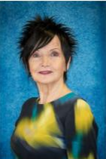
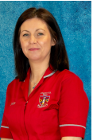
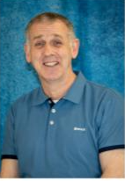
Meet the staff
Mrs Doherty:
Our Secretary
Liam:
Building supervisor
MArtina:
classroom assistant

Slide 5
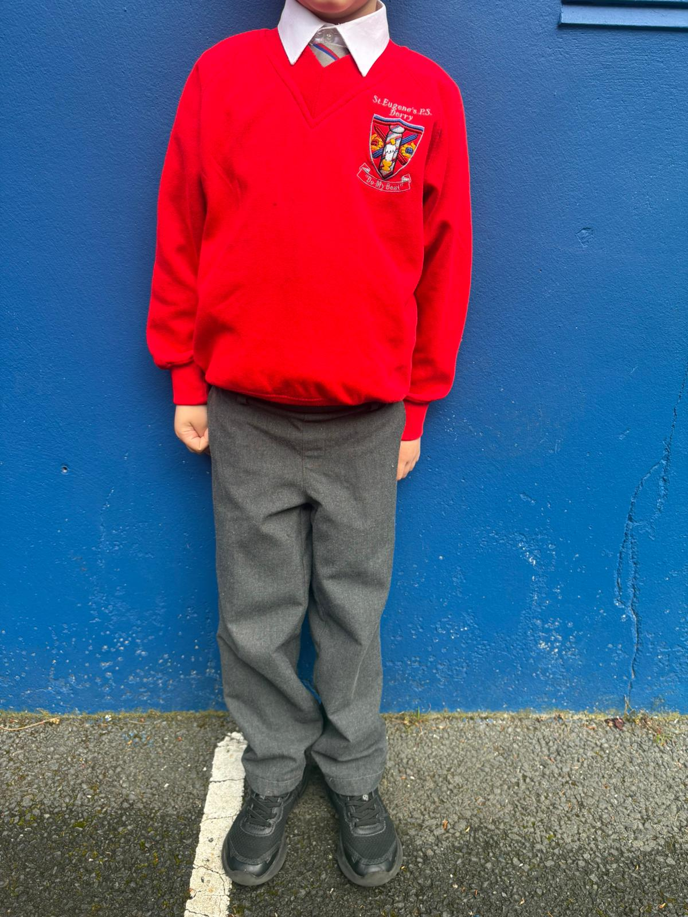
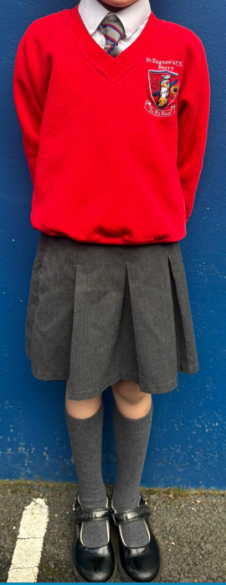
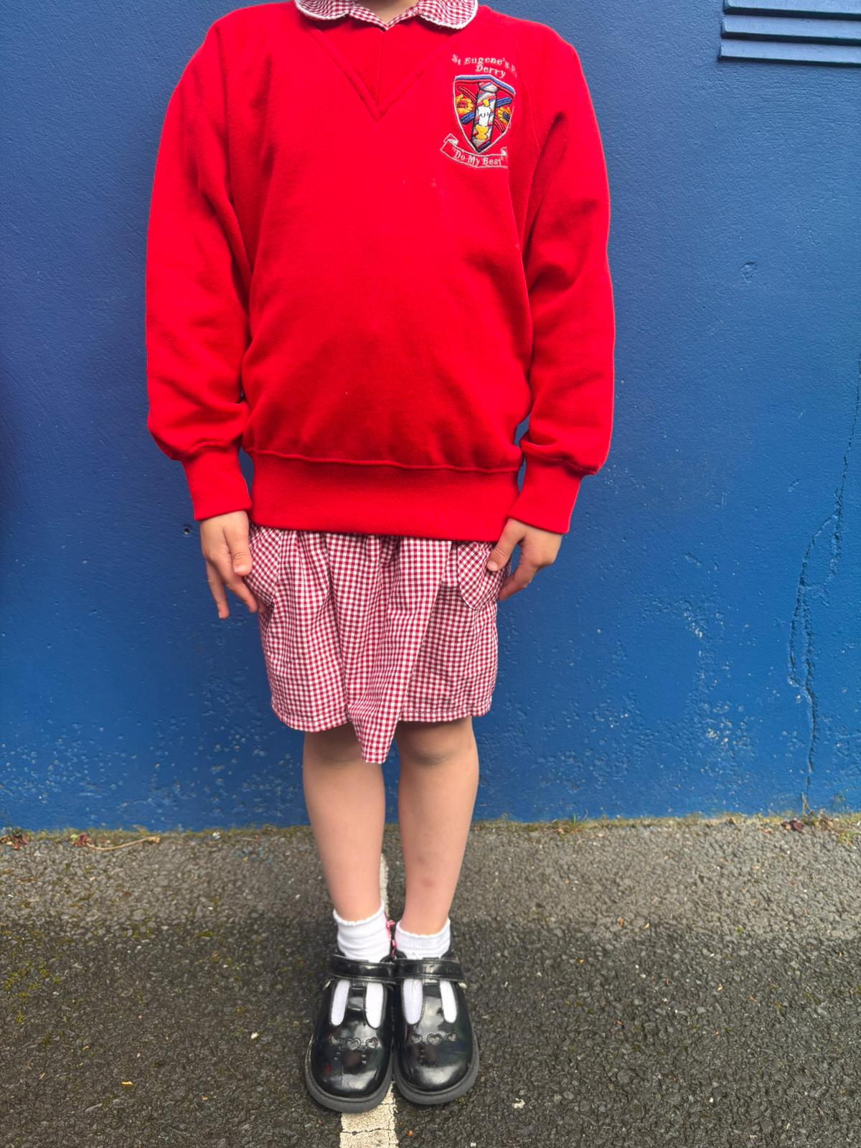
UNIFORM
Our uniform consists of white shirt, red jumper with school logo, grey skirt/trousers/pinafore and a school tie.
Pupils must wear black shoes.
PE uniform is black shorts and a white t-shirt and trainers.
In the summer girls can wear summer dresses and boys can wear grey uniform shorts.

Slide 6


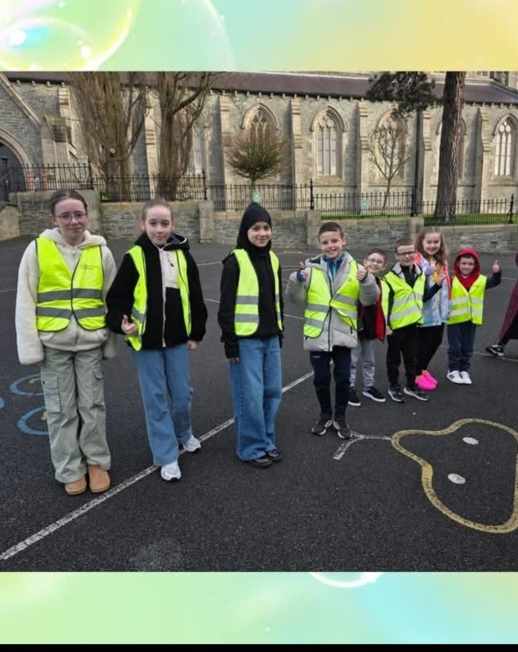
BREAKFAST CLUB
Breakfast club begins at 8am and finishes at 8:30am.
Cost: 50p daily.
Walking Bus- leaves at 8.30am

Slide 7
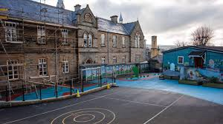

Break time.
Pupils will have a separate break for the 1st two weeks of school to help with the transition.
We follow a Healthy Break policy. Please provide your child with a healthy snack and drink every day. Any dietary needs/allergies please make the office and teacher aware.
Fruit/yoghurt/plain biscuits/cheese/water; no fizzy drinks please.
We are a “Nut Free Zone”, therefore food containing nuts must not be sent to school. This includes Nutella chocolate spread.

Slide 8
FREE SCHOOL MEALS
You may be eligible for Free School Meals if you receive one of the following:
Income Support
Income Based Jobseeker’s Allowance
Income Related Employment and Support Allowance
Child Tax Credit or Working Tax Credit
Universal credit
Or:-
if your child has a statement of special educational needs and is designated to require a special diet.
Parents/Guardians must apply themselves via the EA website. This will open soon so keep an eye on the closing date to ensure that you done miss out.

Slide 9
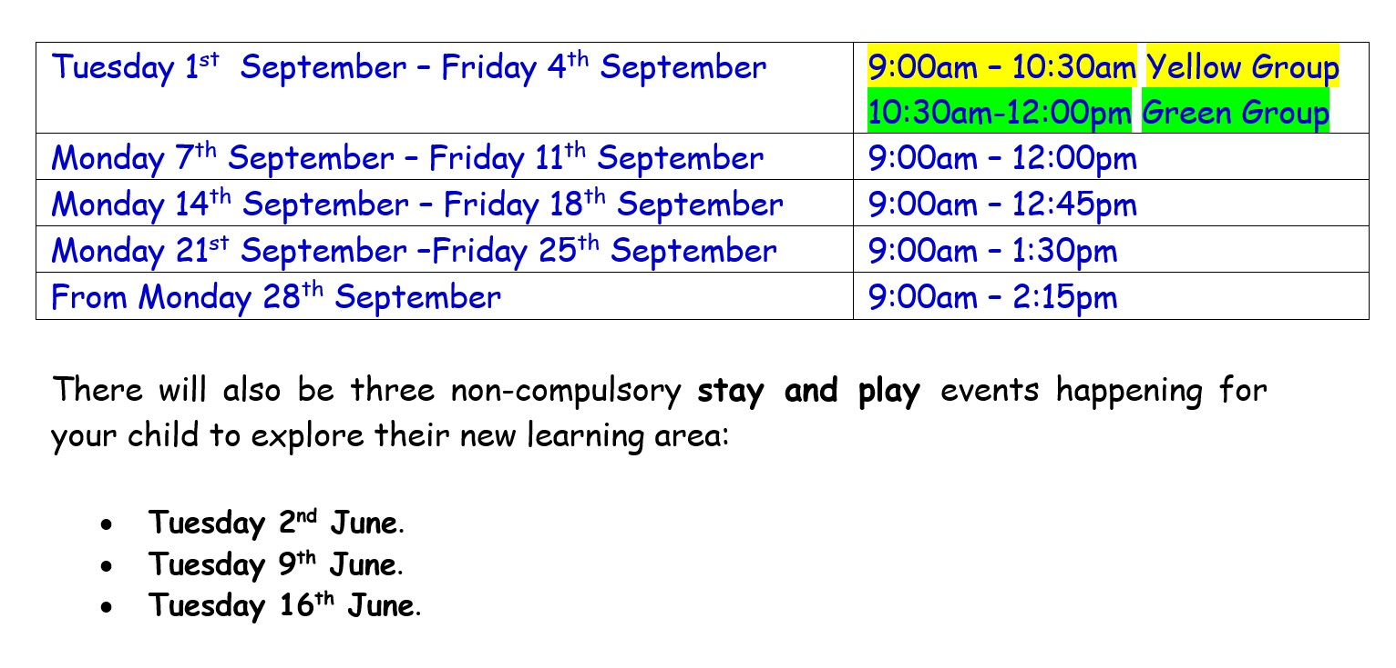
SEPTEMBER HOMETIME/Siblings CLUB
1212.30-1.15pm
Parents who have children further up the school who stay until 3pm can avail of the Siblings Club. We will keep the younger sibling until the designated adult/sibling can collect the pupils. This will only begin when pupils are in a full day.
2:15pm
In October, pupils will
stay until 2.15pm
2.45pm3:00pm

Slide 10

Housekeeping.
Please check your child’s Homework Pack daily for any notes.
If you need to speak to the class teacher, please contact the office to arrange a phone call or meeting.
The gates will be locked at 9:00am and will not reopen until home time. If you need to collect your child early or if they arrive late, please go to the office.
Parent-teacher meetings will be held during the second term.

Slide 11

You child will begin homework in October. Please complete with pencil and sign each piece of work.
Please practise any sounds and keywords sent home daily.
After Christmas, your child will have a reading book at home; please ensure that this is sent in everyday as we use it in class.
If your child finds homework tough; use of timers, stickers, brain breaks maybe beneficial.

Slide 12





P.1.
£15.50 per week
Menu on school website
Provisions
Fruit- £1 per week

Slide 13







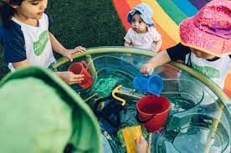
P.1. curriculum
LITERACY
NUMERACY
We use Sounds and Focus to introduce and teach new sounds
Story time
Nursery rhymes
Handwriting – letter formation and holding the pencil correctly
Talking and Listening activities
Reading/Keywords.
Sorting and matching activities
Mental Maths – counting forwards and backwards, 1 more/less
Number rhymes
Number formation
Adding to 10
Money to 10p

Slide 14
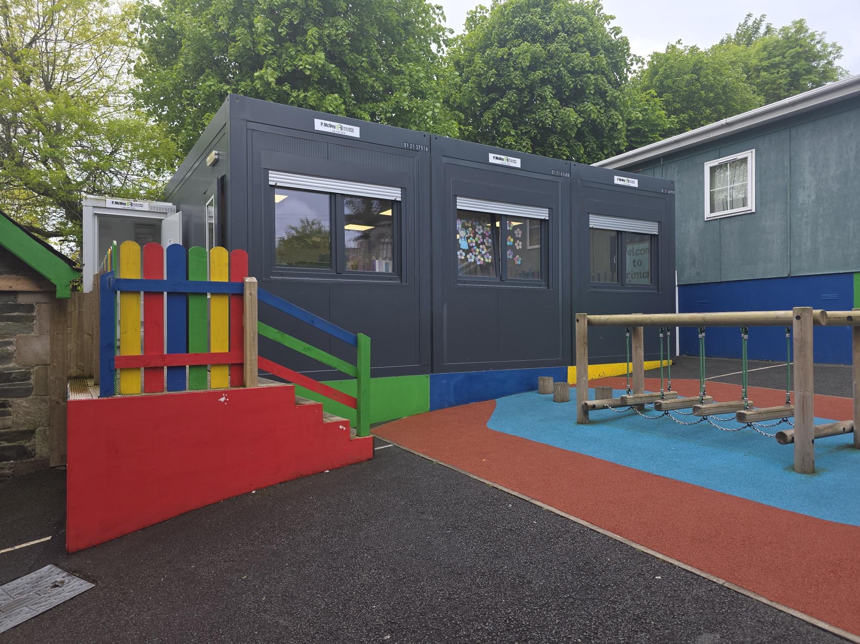
Meet your teacher for 'Stay and Play'
Pupils are invited to attend ‘Stay and Play’ sessions with their new P1 class teacher.
This will take place on June 2nd, 9th and 16th 12.30-1.15pm

Slide 15



Contact us:
If you need to contact us, please use our school telephone 02871261601 or via email: info@steugenes.derry.ni.sch.uk
Communication with parents is via the school app. It is important that you sign up at the beginning of the new term.
We also post updates on our school website and school Facebook and Instagram pages

